Slide 1


Fake News Classification
DSC-680 Applied Data Science
Professor Amirfarrokh Iranitalab
By Gabriel Vance
Notes:
Hello my name is Gabriel Vance.

Slide 2
Background
Fake news refers to the misinformation of events and Updates. It commonly overlaps with gossip, conspiracies, and other lies.
The interest in fake news acts as the primary driving force in traffic. Despite its almost comedic and absurd content, fake news can sow seeds of distrust and confuse the public
Technology has spread to the proliferation of fake news, but it can also aid in combating the spread
Notes:
Examples of fake news:
New York Man Wanted For Infecting 240 Men And Women With HIV!!!
BREAKING: First NFL Team Declares Bankruptcy Over Kneeling Thugs
It can be a public safety, health hazard, it can make people paranoid/depressed, it clutters up the web. And it’s not real journalism or people. It’s heavily manufactured with the intent of getting your attention for advertisement dollars/influence.

Slide 3
Business Objective
Data analysis and machine learning models can help us understand the differences between real and fake news. By understanding these characteristics, we can create models that will predict whether a news article is fake.
To maintain confidence that our model does better than merely guessing true or false, we will evaluate the model on unseen data with a goal of 75% accuracy.
We hope to tell the story of what differentiates real news from fake news and visualize the results.

Slide 4
Data Collection
Kaggle is one of the leading sources of datasets. Not only does it contain a wide variety of datasets, but the data sets are routinely downloaded and evaluated, giving them transparency and criticism from the data science community.
The data was obtained from the FakeNewsNet github repository. The data itself was designated true or false based on the fact checking website politico.

Slide 5
Feature Analysis
The dataset was primarily comprised of 3 features.
  Article title – the text of the article title
    Real - Preventing the Flu: Good Health Habits Can Help Stop Germs
    Fake - BREAKING: First NFL Team Declares Bankruptcy Over Kneeling Thugs
  Tweet ids – The number of times the article was found to be tweeted
    Example: 494471648498941952,494473906578030592,494474086567792640
  URL – The origin source of the URL
    Real – http://www.nbcnews.com/politics/first-read/impeachment-talk-becomes-cynical-game-n168436
    Fake - https://howafrica.com/oscar-pistorius-attempts-commit-suicide/

Slide 6
EDA – Tweet IDS
Tweet ids themselves could be used with the twitter api to find the actual instances of the tweet.
About 30% of real news had 0 tweets, yet the overall mean number of tweet counts was higher for real this. This indicates that most real news is “boring” and largely ignored by the public.
By comparison, only 9% of fake news had 0 tweets. When standardized, Fake news was 38% more tweeted than real news.

Slide 7
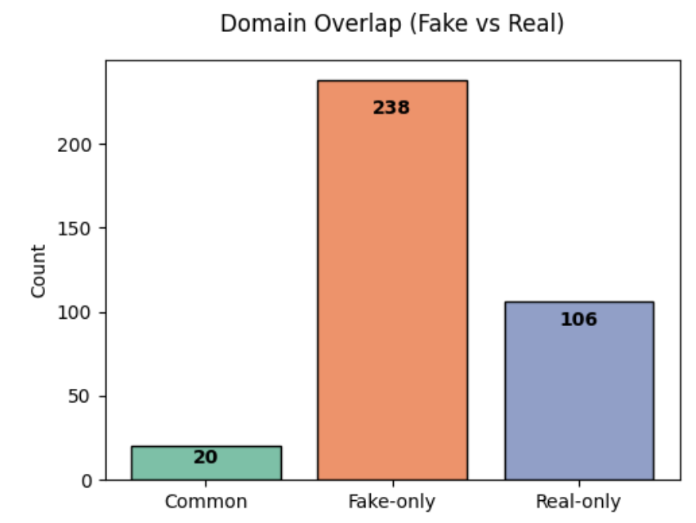
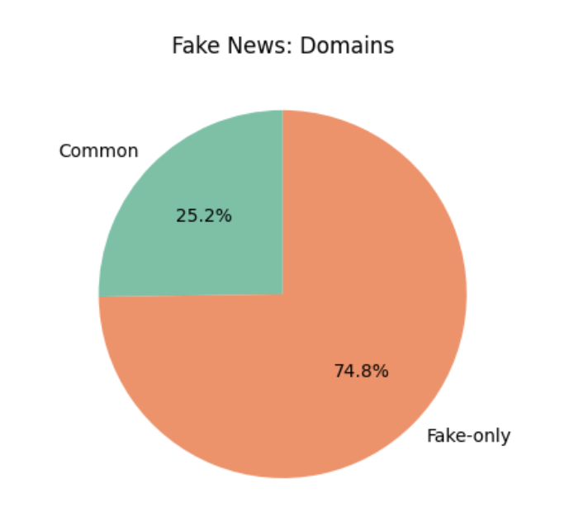
EDA – URLs
URLs were a primary source for discerning real vs fake news
Using Python libraries like tldextract, we can gather a list of domains and associate them with their respective datasets.

Slide 8
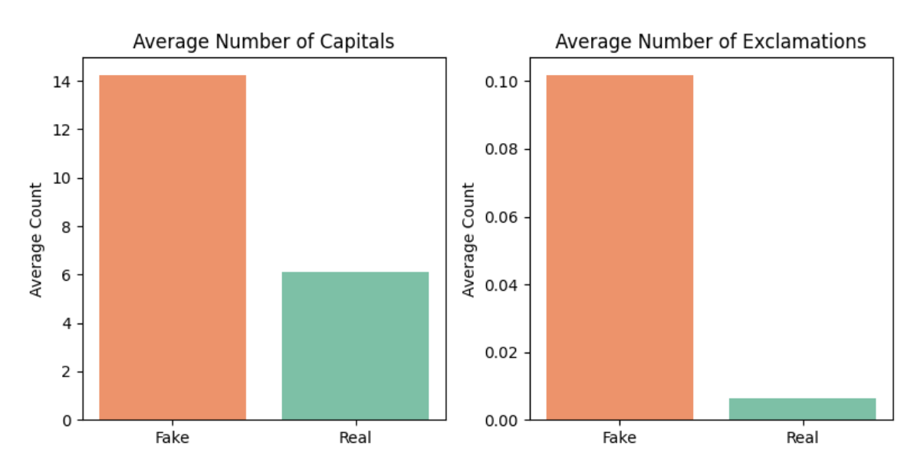
EDA - Titles
Titles contained our primary text or gateway into the writing style of fake news.
Certain characteristics were noted, such as the excessive use of capitalizations and exclamation marks

Slide 9
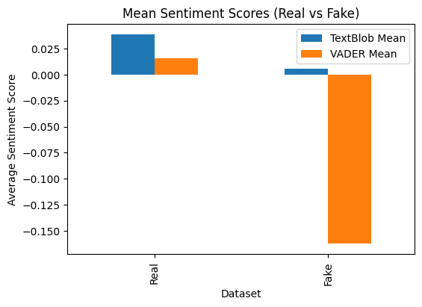
EDA - Titles
Sentiment analysis was measured using Textblob and vader
Both passed the t-test as they had values below 0.05, but vader excelled at discerning between the sentiments. It classified fake news as significantly more negative.

Slide 10
Modeling
For training, we created a data pipeline for preparing data. Categorical data was encoded whilst numerical data was passed through. Text data was processed using tfid vectorization.
We experimented with three different model types, following the suggestion of a similar fake news study by Elsa Norman.
  XGBoost – Gradient boost handling various forms of data types
  Logistic Regression – Calibrated baseline, lightweight
  Linear SVC – effective with text features
Notes:
Norman, Elsa. “Detecting Fake News Using Machine Learning.” Journal of Student
Research, vol. 12, no. 1, 28 Feb. 2023, https://doi.org/10.47611/jsrhs.v12i1.3940.
Accessed 5 May 2023.

Slide 11
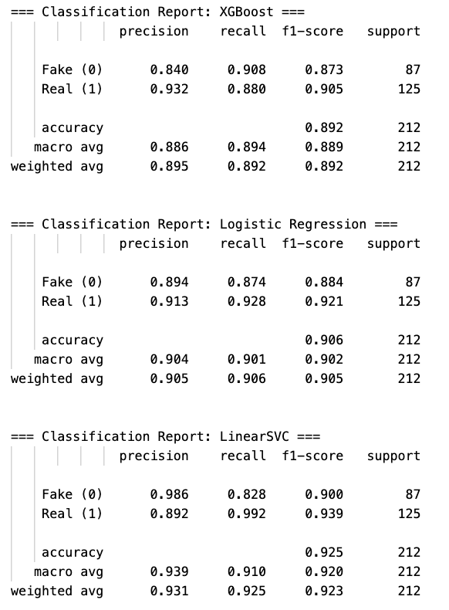
Modeling Results
All models passed the threshold of 75%
XGBoost struggled to predict fake news in 16% of cases.
Logistic regression did slightly better, but Linear SVC maintained an almost 99% precision for predicting fake news.
The modeling shows that fake news has predictable attributes, regardless of which model is used, though svc appears to be the winner.

Slide 12
Conclusions
Fake news has unique characteristics that can be exploited for identification. These identifications do not need to be robust or computationally expensive, but can instead rely on simple pieces of data, such as the url source and textual hints in the title.
The analysis and modeling have shown disparities between the data. Because of the minimal data required, a full pipeline could be deployed to extract the title and url of fake news articles and flag them before they are shared on social media.
The model itself is more like a ”spam” detector as it aims for key characteristics of text.
The most important feature was the domain.

Slide 13
Ethical Concerns
Free speech
  Fake news is not the same as free speech. These news articles were not the result of someone sharing their opinion, but heavily manufactured news curated to achieve a purpose, such as shock or spam. Targeting spam from domains is not the same as silencing an individual sharing their opinions and beliefs.
Financial
  The engagement of fake news is higher than real news after controlling for outliers and standardization. This traffic incentivizes platforms such as X and Facebook to allow fake news because it increases the revenue they gain from advertising. It is unlikely that these businesses will be willing to reign in fake news because their competitors will gain that market.
Security
  Fake news consistently points to domains without basic security protocols. They are set up for scams to manipulate the gullible.

Slide 14
References
Works Cited
Golovin, Aleksei. “Fake News.” Www.kaggle.com, 2021, www.kaggle.com/datasets/algord/fake-news.
Halyna Padalko, et al. “A Novel Approach to Fake News Classification Using LSTM-Based Deep Learning Models.” Frontiers in Big Data, vol. 6, no. 1320800, 8 Jan. 2024, https://doi.org/10.3389/fdata.2023.1320800.
Norman, Elsa. “Detecting Fake News Using Machine Learning.” Journal of Student Research, vol. 12, no. 1, 28 Feb. 2023, https://doi.org/10.47611/jsrhs.v12i1.3940. Accessed 5 May 2023.

